Slide 1

PROPER DOC
Automated Document Verification: Streamlining Online Forms

Slide 2



The Challenge of Document Errors
Incorrect Documents
Time-Consuming Verification
Delayed Processing
Users often upload the wrong documents when filling out online forms.
Manual verification is time-consuming and inefficient.
Errors are identified only after submission, leading to delays.

Slide 3
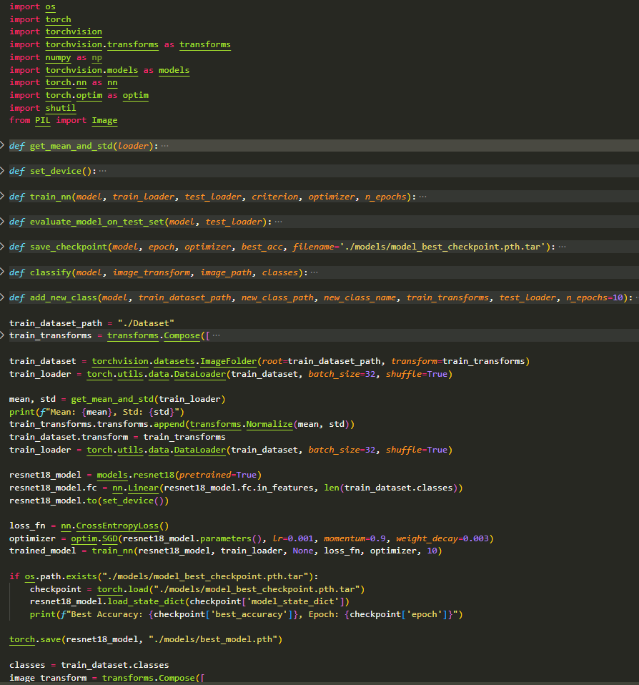

ML - Powered Solution
1
Real-time Verification
2
Immediate Feedback
Users are notified instantly if an incorrect document is uploaded.
Our ML system can verify documents in real time before submission.
3
Error-Free Submissions
Ensures smooth and error-free form submissions.

Slide 4

Implementation
Data Collection
1
Gathered images of various document types (Aadhar cards, PAN cards, etc.) for training the ResNet-18 model.
2
Preprocessing
Converted images to a uniform size using transforms
(resize) and normalized them using dataset
mean and standard deviation
Feature Extraction
Used ResNet-18, a pre-trained CNN, to extract deep learning features.
OCR integration can be added for text feature extraction if needed.
3
Model Training
4
Fine-tuned ResNet-18 using a custom dataset with CrossEntropyLoss and SGD optimizer for document classification.
Supports adding new classes dynamically with further training.
Real-time Verification
5
Classify uploaded images immediately using the classify() function for real-time validation
6
Integration
The trained model can be embedded into a web application for live
document classification and validation.

Slide 5


Benefits
Reduced Errors
Improved Efficiency
Faster Processing
The project aims to significantly reduce document submission errors.
Real-time verification improves efficiency and user experience.
Helps organizations process applications faster with fewer rejections.

Slide 6




Applications
Government Portals
Streamlines applications for licenses, permits, and benefits.
Reduces document-related errors and processing time.
Banking
Loan and Credit Card Applications:
Reduces document-related rejections in loan processing.

Slide 7

Conclusion
Efficient Document Classification: The project successfully classifies images of documents like Aadhar cards and PAN cards using a pre-trained ResNet-18 model.
Customizable for New Classes: The system allows easy addition of new document types with minimal retraining.
Real-Time Performance: Real-time classification ensures immediate feedback on uploaded images.
Integration with Web Applications: The model can be integrated into web forms for live verification, enhancing usability.
Scalability: The approach can be scaled to handle larger datasets and additional document types.
Practical Application: This solution is ideal for digital document verification in sectors like banking, government, and online services.

